Slide 1
Capstone Project
Telecom Churn Data – EDA Team - stars 1. Sai Krishna Vamshi Devarasetty (krishnavamshidevarasetty@gmail.com) 2. Gangadhar Palle (pallegangadhar156@gmail.com) 3. Abhishek Sharma (abhisheksharmatrio@gmail.com) 4. Nitish Rao – (nitishrao1896@gmail.com)

Slide 2
Telecom Churn Data – Intro
Orange S.A., formerly France Telecom S.A., is a French multinational telecommunications corporation. The Orange Telecom's Churn Dataset, consists of cleaned customer activity data (features), along with a churn label specifying whether a customer canceled the subscription.

Slide 3
Data Description
State – The state the telecom service user belongs to.
Account Length – How long account has been active.
Area Code – Identifier for a geographic region.
International Plan – Did user opted for International Plan ?
Voice mail Plan – Is Voice mail plan activated?
Number vmail messages – Number of voice mail messages sent.
Total day minutes–Total minutes used in day.
Total day calls – Total day calls made.
Total day charge – Total price user was charged for day calls.
Total eve minutes – Total minutes used
for calls in evening.
Total eve calls – Total evening calls made.
Total eve charge – Total price user was charged for evening calls.
Total night minutes – Total minutes used for calls in night.
Total night calls – Total night calls made.
Total night charge – Total price user was charged for night calls.
Total intl minutes – Total minutes used for international calls.
Total intl calls – Total calls made for international numbers
Total intl charge – Total price user was charged for international calls
Customer service calls – Number of Customer service calls user made.
Churn – Did user churned the services?

Slide 4
About Data
There are no missing values in any of the columns.
Except State, International plan, Voice mail plan and Churn all other columns are numerical(either int64 or float64)
Even though Area Code is numerical, it is not ordinal.
State is the only variable which is a string.
International plan and Voice mail plan are also given as type string(Yes/No) but we need to considered them as Boolean for analysis
Churn is bool type, True meaning users have churned and False implies who didn’t churned
Out of 3333 users 483 users Churned and 2850 didn’t churned

Slide 5
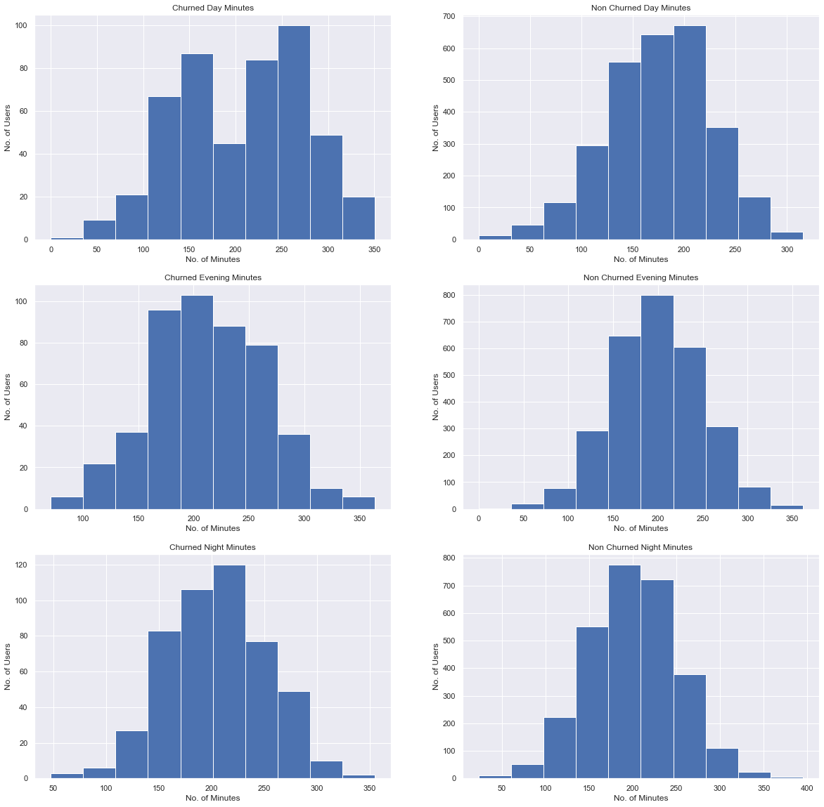
Frequency Distribution(Histogram Plot) of Churned vs Non Churned Users based Total Minutes users used during day, evening and night

Slide 6
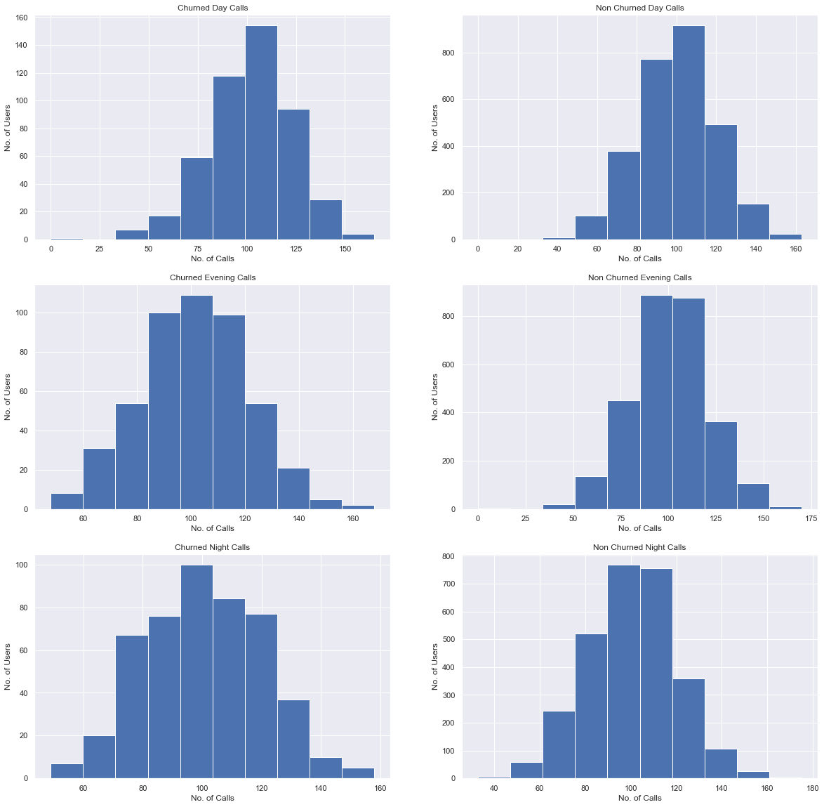
Frequency Distribution(Histogram Plot) of Churned vs Non Churned Users based Total calls users made used during day, evening and night

Slide 7

Frequency Distribution(Histogram Plot) of Churned vs Non Churned Users based Total price users were charged used during day, evening and night

Slide 8
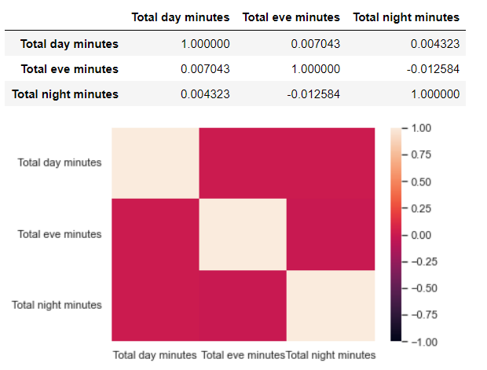
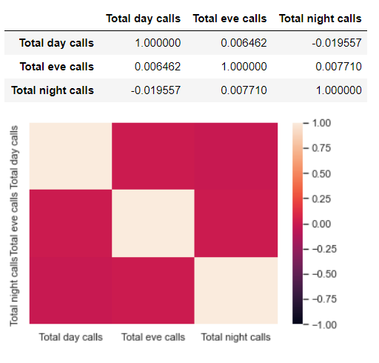
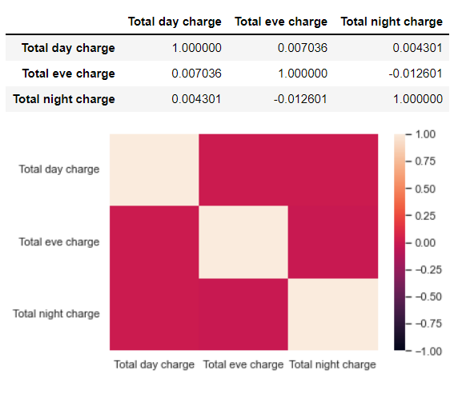
Correlation among Day, Evening and Night Times for Minutes, Calls and Charges

